Slide 1
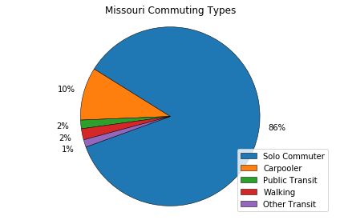
Statewide Analysis
As expected, a massive majority of Missouri commuters are “Solo Commuters”
Commuter proportions very similar county to county. Highest amounts of commuters are located in Kansas City, St. Louis and along I-44.
A very small amount of commuters represented who use public transit, walk or are listed as using “other transit”.
We love our cars!

Slide 2
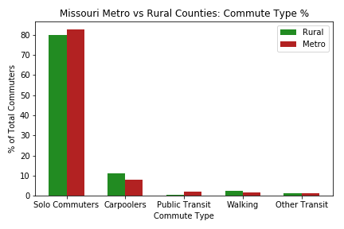
Urban vs. Rural Analysis
Not a very significant level of difference.
By conducting an independent t-test it was found that rural areas do have a decently higher amount of carpoolers and walking commuters.
This could be due to people living in closer proximity to their place of work in rural areas.

Slide 3
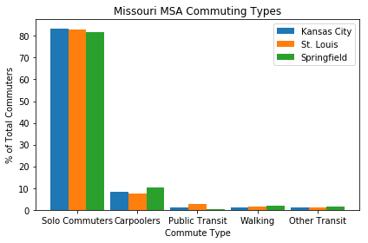
Metro vs. Metro Analysis
An ANOVA test revealed significant differences for commute types % between the cities.
A T-Test showed Carpooler % between Kansas City and St. Louis to be significant
Visually notable differences include amount of carpoolers and amount of walking commuters in Springfield.
This could be due to higher percentage of people living/working near or on a college campus.

